Slide 1
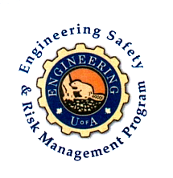
Fundamentals of RM
RM System and Process
Leadership in RM
Incident Investigation
RM Tools & Challenges
RM in Industry
People & Org.
Application and Perspectives
On Becoming a Leader
in Risk Management
ENGG404 - Lecture
Chapter 3.3: RME #04
Management of Change (MOC)

Slide 2
Learning Outcomes:
Explain the purpose of a basic Management Of Change (MOC) work process, the manner in which it is used, and the benefits for managing change.
Explain the need to manage change by gaining an appreciation about the potential changes in risk as a change in the activity, the technology of the operation, or organization (structure and people) is made.
Explain the significance of the “Management of Change” element in a Risk Management System.
Apply the basic MOC work process.
Chapter 3.3: RME #04 Management of Change (MOC)
2
Notes:
2

Slide 3
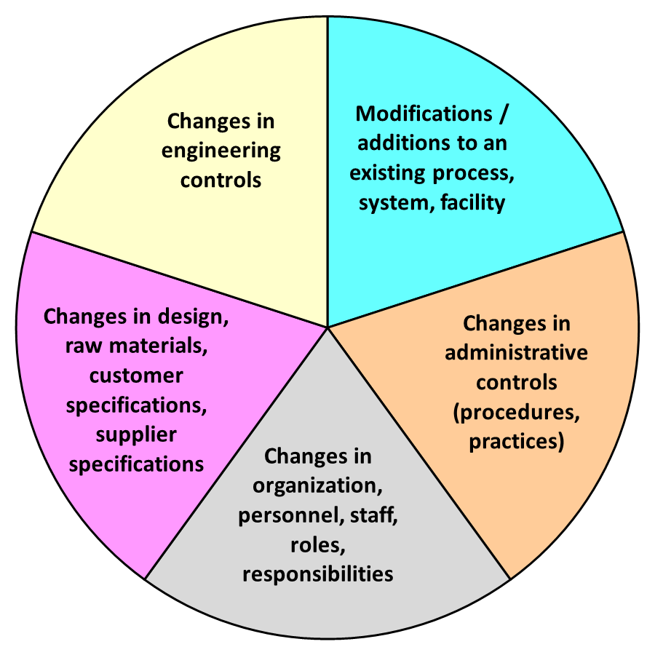
Introductory Points About “Change”.
Change is Normal Part of Business:
Change requires appropriate management system oversight to ensure that the change does not introduce new risks, or change control measures for existing risks.
Look at Change in Terms of a Change in Risk Level:
Does the change introduce a new or different risk, or affect the effectiveness of existing control measures (administrative controls and/or engineering controls)?
Management of Change Applies To:
Almost any kind of change!
Chapter 3.3: RME #04 Management of Change (MOC)
3
Notes:
3

Slide 4
How is MOC linked to the Risk Management System?
Management Leadership, Commitment and Accountability.
Risk Assessment and Management of Risks.
Community Awareness and Emergency Preparedness.
Management of Change.
Incident Reporting, Investigation, Analysis and Actions.
Program Evaluation and Continuous Improvement.
Design, Construction and Start-up.
Operations and Maintenance.
Employee Competency and Training.
Contractor Competency and Integration.
Operations and Facilities Information and Documentation.
You can expect that everywhere you go in your career the organization will have a MOC program. MOC is almost universal.
And if it doesn’t, what are you going to do?
Implement a “Management of Change” Program in areas
under your responsibility.
Chapter 3.3: RME #04 Management of Change (MOC)
4
Notes:
4

Slide 5
Example: MOC Basic Examples
MOC should or should not apply as shown:
1) I bought a new piece of equipment to replace an old one.
1a) NEW is same as OLD, same operating procedures: NO
1b) NEW is different from OLD, different operating procedures: YES
2) My design lead engineer retired & I appointed a replacement. YES
3) Our organization was bought by a larger enterprise and we need to follow their administrative controls (policies, protocols, etc.). YES
4) The ore host rock has changed and we need to adjust the extraction processes.
4a) Within expected changes & extraction process design limits: NO
4b) Outside expected changes & extraction process design limits: YES
Chapter 3.3: RME #04 Management of Change (MOC)
5
Notes:
5

Slide 6
Who is Responsible for Management of Change?
Several Roles:
Several roles involved in managing the change, each becomes involved as the proposed change progresses through the work process.
Recall RACI: Responsible, Accountable, Consulted, Informed
The Change Owner (Person driving the change): Responsible
The Stakeholders: Informed, Consulted
Subject-matter Experts: Responsible, Consulted, Informed
  Managers.
  Those affected by or subject to the change.
  Those who will implement the change.
Final Approver: Accountable for ensuring that the MOC work process has been followed!
Chapter 3.3: RME #04 Management of Change (MOC)
6
Notes:
6

Slide 7
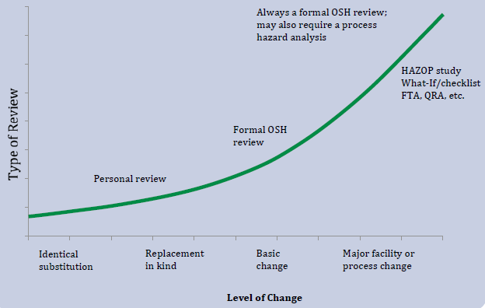
Type of Risk Assessment & Level of Change
Matching the type of risk assessment to the level/complexity of the change is a critical part of the management of change process.
Chapter 3.3: RME #04 Management of Change (MOC)
7
Notes:
7

Slide 8
Four Critical Actions for MOC:
Four Critical Actions:
The Change Owner must drive these four actions in MOC:
Every organization may have different
procedures for each action
These 4 critical actions are integrated within
the MOC WP!
(1)
Communicate the Proposed Change
(2)
Conduct Appropriate Reviews & Risk Assessments
(3)
Seek Final Approval
(4) Communicate & Implement the Change
Chapter 3.3: RME #04 Management of Change (MOC)
8
Notes:
8

Slide 9
Management of Change is Critical!
The causes of many incidents include the failure to:
Communicate the change;
Conduct appropriate reviews and risk assessments;
Seek and gain final approval;
Implement the change as agreed upon and approved by all stakeholders.
APEGA RM System Element # 4 Management of Change
Can weaknesses in the MOC Work Process / Program
be latent causes?
YES?
NO?
NOT SURE?
Chapter 3.3: RME #04 Management of Change (MOC)
9
Notes:
9

Slide 10
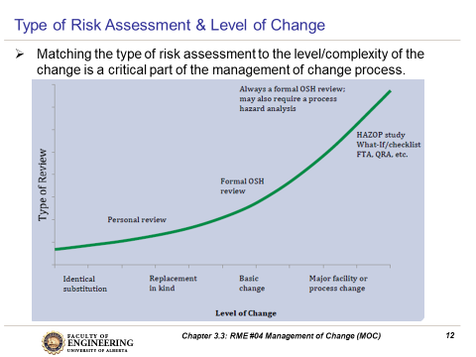
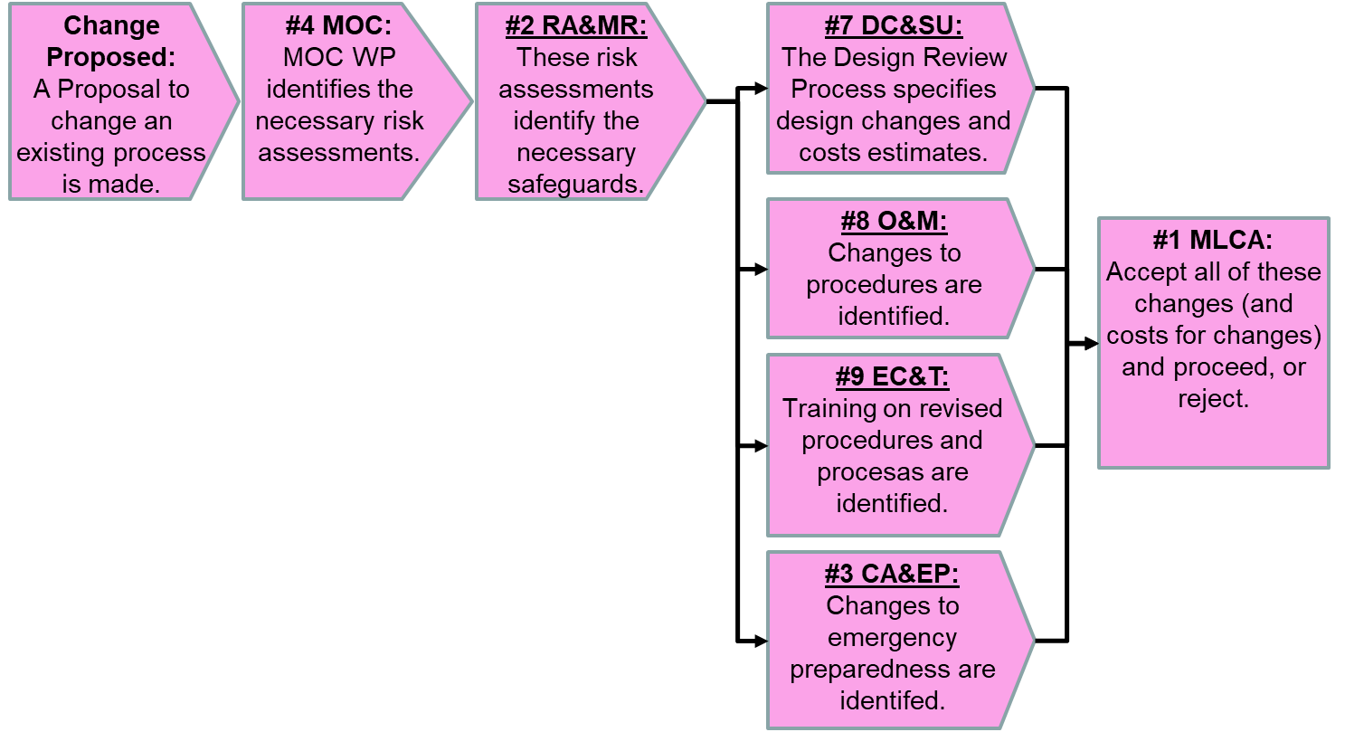
Example: Proposal to Convert a Storage Tank from Jet Fuel to Gasoline
Proposed change: Convert 2 of the 3 jet fuel storage tanks to gasoline storage.
Yes, the MOC work process does apply. A change is being proposed, to this triggers the action to initiate the MOC work process.
Design parameters pertaining to your field of expertise:
The complexity of the overall change: Major Process (significant) Change
These risk management system elements come into play:
#1 MLCA
#2 Risk Assessment and Management of Risk;
#3 Emergency Preparedness;
#4 MOC;
#7 Design, Construction & Startup;
#8 Operations & Maintenance;
#9 Employee Competency & Training;
You should consult with the following SMEs (Subject-Matter Experts):
Chemical Eng. / MechE / Fire Protection Specialist / Operations and
Maintenance Personnel / Trainers / Emergency Response Team, etc.!
Hazardous material (Jet Fuel for Gas) Piping to prevent cross-contamination Tank and piping labelling Procedures and re-training Software process controls (reprogram) Tank wall strength Compatibility of materials of construction | Foundation strength / underground facilities Secondary containment Leak detection systems, alarms, fire protection Instrumentation (recalibrations) Electrical classification Pressure / vacuum relief systems Emissions (air pollution) control systems
Chapter 3.3: RME #04 Management of Change (MOC)
10
Notes:
10

Slide 11
MOC and How it is Integrated Into the RM System:
MOC is NOT Stand-alone – a proposal triggers this typical process:
Each system element within the RM
Program assesses risks relevant to its
scope, and determines the necessary
detailed changes.
A decision is made, a management /
leadership decision, on a risk-informed
basis as to proceed or not.
If risks can be managed to an
acceptable level, then costs are
estimated for all design changes; a
decision is made on an economic basis
as to proceed or not.
Change Proposed:
A Proposal to change an existing process is made.
#4 MOC:
MOC WP identifies the necessary risk assessments.
#2 RA&MR:
These risk assessments identify the necessary safeguards.
#7 DC&SU:
The Design Review Process specifies design changes and costs estimates.
#8 O&M:
Changes to procedures are identified.
#1 MLCA:
Accept all of these changes (and costs for changes) and proceed, or reject.
#9 EC&T:
Training on revised procedures and procesas are identified.
#3 CA&EP:
Changes to emergency preparedness are identifed.
Chapter 3.3: RME #04 Management of Change (MOC)
11
Notes:
11

Slide 12
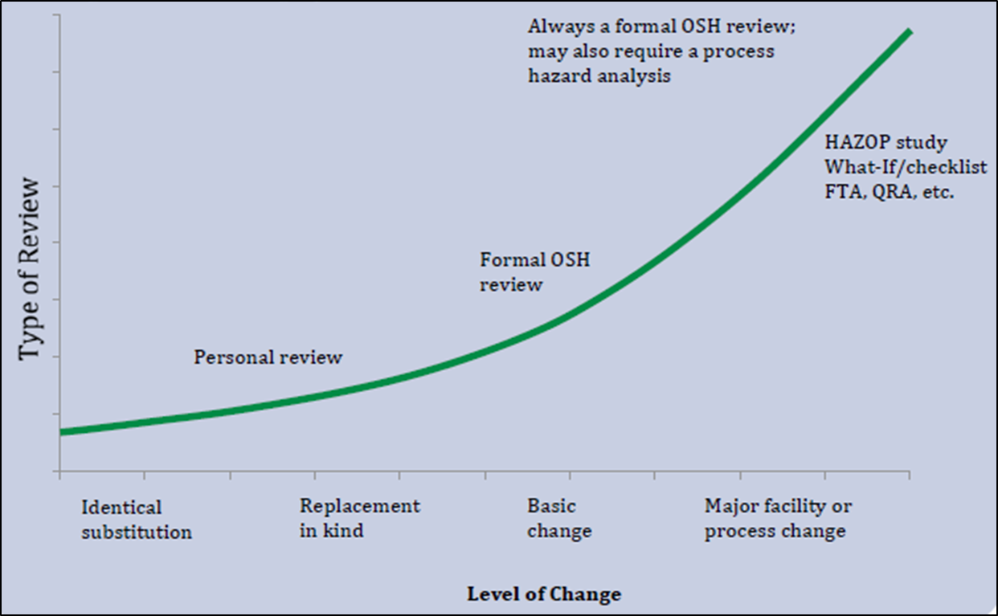
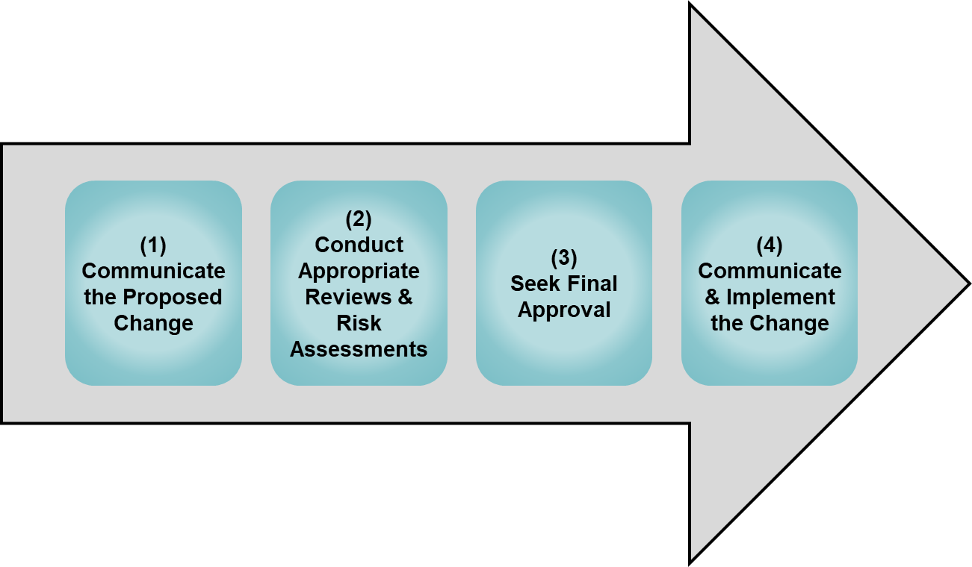
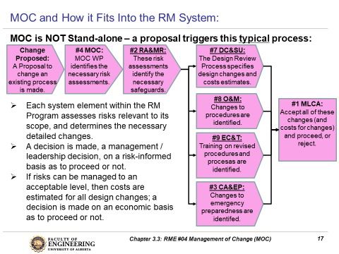
Summary and Key Lesson:
Changes are common occurrences in organizations.
If the word “change” is mentioned in a proposal, it is highly likely that RME #4 MOC and the MOC WP will apply!
MOC WP is applicable at every level of the organization & for every change.
The depth and scope of review in the
MOC depends on the complexity of the
scope of the proposed change.
The four critical actions are essential for
an effective application of MOC WP.
The MOC WP triggers reviews in many other elements.
Change sets the stage for errors …
… and errors lead to loss incidents.
Chapter 3.3: RME #04 Management of Change (MOC)
12
Notes:
12

Slide 13
Complete Slide Deck follows with details.
13
Notes:
13

Slide 14
Learning Outcomes:
Explain the purpose of a basic Management Of Change (MOC) work process, the manner in which it is used, and the benefits for managing change.
Explain the need to manage change by gaining an appreciation about the potential changes in risk as a change in the activity, the technology of the operation, or organization (structure and people) is made.
Explain the significance of the “Management of Change” element in a Risk Management System.
Apply the basic MOC work process.
Chapter 3.3: RME #04 Management of Change (MOC)
14
Notes:
14

Slide 15
Introductory Points About “Change”.
Change is Normal Part of Business:
Change requires appropriate management system oversight to ensure that the change does not introduce new risks, or change control measures for existing risks.
Look at Change in Terms of a Change in Risk Level:
Does the change introduce a new or different risk, or affect the effectiveness of existing control measures (administrative controls and/or engineering controls)?
Management of Change Applies To:
Almost any kind of change!
Chapter 3.3: RME #04 Management of Change (MOC)
15
Notes:
15

Slide 16
Look at Change in Terms of a Change in Risk Level:
Does the Risk Level Change?
Management needs to look at change in terms of a change in risk level and the consequences of the change:
Does the change introduce a new or different risk?
Hazards? Likelihoods? Consequences?
Does the change affect the effectiveness of existing safeguards and control measures e.g. engineering controls?
Does the change affect the effectiveness of efficiency of administrative controls (policies, procedures, checklists, etc.) and work practices?
New training materials?
New or refresher training?
New people in new roles?
Chapter 3.3: RME #04 Management of Change (MOC)
16
Notes:
16

Slide 17
When A Change Occurs Or A Change Is Planned:
Change is Normal Part of Business:
Change is an accepted fact of business for all areas of an operation or an organization
Management must ensure their employees:
  Understand that change is a normal part of operations.
  Have the tools to clarify the scope of change and evaluate it.
  Understand the requirements for reviews and for levels of approval.
Change requires appropriate management system oversight to ensure that the change does not introduce new risks, or diminish (change) control measures for existing risks.
Chapter 3.3: RME #04 Management of Change (MOC)
17
Notes:
17

Slide 18
Management of Change Applies To:
Any kind of change must be considered because a change has the potential to introduce increases in risk and loss exposures.
Scope and Stage: small and large scale projects at all stages (conception-design-construction-operation- maintenance):
Changes beyond well-defined limits (i.e. exceed specifications)
require formal MOC reviews.
Both temporary and permanent changes.
  Temporary changes can be overlooked or “forgotten”, or accepted as permanent because “it has been successful”
  Rigorous implementation of control measures may NOT have been executed along with the temporary change.
Chapter 3.3: RME #04 Management of Change (MOC)
18
Notes:
18

Slide 19
MOC Applies To …
Broad Areas to which MOC applies:
Consider your Team Project Loss Incident:
Was a change, or lack of the
management of a change, or an inadequate
Management of Change Program apparent and applicable?
Many loss incidents are the outcome of a change!
Chapter 3.3: RME #04 Management of Change (MOC)
19
Notes:
19

Slide 20
How is MOC linked to the Risk Management System?
Management Leadership, Commitment and Accountability.
Risk Assessment and Management of Risks.
Community Awareness and Emergency Preparedness.
Management of Change.
Incident Reporting, Investigation, Analysis and Actions.
Program Evaluation and Continuous Improvement.
Design, Construction and Start-up.
Operations and Maintenance.
Employee Competency and Training.
Contractor Competency and Integration.
Operations and Facilities Information and Documentation.
You can expect that everywhere you go in your career the organization will have a MOC program. MOC is almost universal.
And if it doesn’t, what are you going to do?
Implement a “Management of Change” Program in areas
under your responsibility.
Chapter 3.3: RME #04 Management of Change (MOC)
20
Notes:
20

Slide 21
Example: MOC Basic Examples
MOC should or should not apply as shown:
1) I bought a new piece of equipment to replace an old one.
1a) NEW is same as OLD, same operating procedures: NO
1b) NEW is different from OLD, different operating procedures: YES
2) My design lead engineer retired & I appointed a replacement. YES
3) Our organization was bought by a larger enterprise and we need to follow their administrative controls (policies, protocols, etc.). YES
4) The ore host rock has changed and we need to adjust the extraction processes.
4a) Within expected changes & extraction process design limits: NO
4b) Outside expected changes & extraction process design limits: YES
Chapter 3.3: RME #04 Management of Change (MOC)
21
Notes:
21

Slide 22
Who is Responsible for Management of Change?
Several Roles:
Several roles involved in managing the change, each becomes involved as the proposed change progresses through the work process.
Recall RACI: Responsible, Accountable, Consulted, Informed
The Change Owner (Person driving the change): Responsible
The Stakeholders: Informed, Consulted
Subject-matter Experts: Responsible, Consulted, Informed
  Managers.
  Those affected by or subject to the change.
  Those who will implement the change.
Final Approver: Accountable for ensuring that the MOC work process has been followed!
Chapter 3.3: RME #04 Management of Change (MOC)
22
Notes:
22

Slide 23
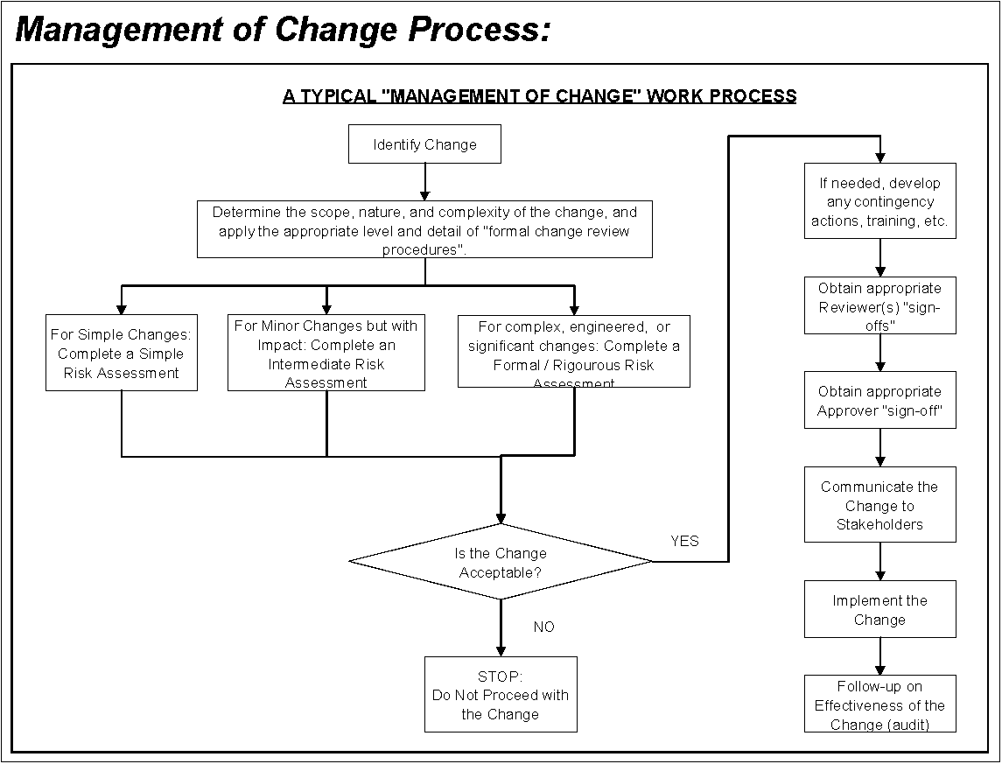
A Typical MOC Work Process:
Extent of risk review is proportional and commensurate with the change complexity.
Chapter 3.3: RME #04 Management of Change (MOC)
23
Notes:
23

Slide 24
Type of Risk Assessment & Level of Change
Matching the type of risk assessment to the level/complexity of the change is a critical part of the management of change process.
Chapter 3.3: RME #04 Management of Change (MOC)
24
Notes:
24

Slide 25
Four Critical Actions for MOC:
Four Critical Actions:
The Change Owner must drive these four actions in MOC:
Every organization may have different
procedures for each action
These 4 critical actions are integrated within
the MOC WP!
(1)
Communicate the Proposed Change
(2)
Conduct Appropriate Reviews & Risk Assessments
(3)
Seek Final Approval
(4) Communicate & Implement the Change
Chapter 3.3: RME #04 Management of Change (MOC)
25
Notes:
25

Slide 26
Management of Change is Critical!
The causes of many incidents include the failure to:
Communicate the change;
Conduct appropriate reviews and risk assessments;
Seek and gain final approval;
Implement the change as agreed upon and approved by all stakeholders.
APEGA RM System Element # 4 Management of Change
Can weaknesses in the MOC Work Process / Program
be latent causes?
YES?
NO?
NOT SURE?
Chapter 3.3: RME #04 Management of Change (MOC)
26
Notes:
26

Slide 27
Example: Proposal to Convert a Storage Tank from Jet Fuel to Gasoline
Proposed change: Convert 2 of the 3 jet fuel storage tanks to gasoline storage.
Yes, the MOC work process does apply. A change is being proposed, to this triggers the action to initiate the MOC work process.
Design parameters pertaining to your field of expertise:
The complexity of the overall change: Major Process (significant) Change
These risk management system elements come into play:
#1 MLCA
#2 Risk Assessment and Management of Risk;
#3 Emergency Preparedness;
#4 MOC;
#7 Design, Construction & Startup;
#8 Operations & Maintenance;
#9 Employee Competency & Training;
You should consult with the following SMEs (Subject-Matter Experts):
Chemical Eng. / MechE / Fire Protection Specialist / Operations and
Maintenance Personnel / Trainers / Emergency Response Team, etc.!
Hazardous material (Jet Fuel for Gas) Piping to prevent cross-contamination Tank and piping labelling Procedures and re-training Software process controls (reprogram) Tank wall strength Compatibility of materials of construction | Foundation strength / underground facilities Secondary containment Leak detection systems, alarms, fire protection Instrumentation (recalibrations) Electrical classification Pressure / vacuum relief systems Emissions (air pollution) control systems
Chapter 3.3: RME #04 Management of Change (MOC)
27
Notes:
27

Slide 28
MOC and How it is Integrated Into the RM System:
MOC is NOT Stand-alone – a proposal triggers this typical process:
Each system element within the RM
Program assesses risks relevant to its
scope, and determines the necessary
detailed changes.
A decision is made, a management /
leadership decision, on a risk-informed
basis as to proceed or not.
If risks can be managed to an
acceptable level, then costs are
estimated for all design changes; a
decision is made on an economic basis
as to proceed or not.
Change Proposed:
A Proposal to change an existing process is made.
#4 MOC:
MOC WP identifies the necessary risk assessments.
#2 RA&MR:
These risk assessments identify the necessary safeguards.
#7 DC&SU:
The Design Review Process specifies design changes and costs estimates.
#8 O&M:
Changes to procedures are identified.
#1 MLCA:
Accept all of these changes (and costs for changes) and proceed, or reject.
#9 EC&T:
Training on revised procedures and procesas are identified.
#3 CA&EP:
Changes to emergency preparedness are identifed.
Chapter 3.3: RME #04 Management of Change (MOC)
28
Notes:
28

Slide 29
Summary and Key Lesson:
Changes are common occurrences in organizations.
If the word “change” is mentioned in a proposal, it is highly likely that RME #4 MOC and the MOC WP will apply!
MOC WP is applicable at every level of the organization & for every change.
The depth and scope of review in the
MOC depends on the complexity of the
scope of the proposed change.
The four critical actions are essential for
an effective application of MOC WP.
The MOC WP triggers reviews in many other elements.
Change sets the stage for errors …
… and errors lead to loss incidents.
Chapter 3.3: RME #04 Management of Change (MOC)
29
Notes:
29

